Slide 1
Assignment2 CLO2(Applying)
Question1(A):
Calculate the magnitudes when , Fig(a), two particles (1 and 2) each have a charge of +20.0 μC and are held at a separation distance d=1.50 m.
(a) What is the magnitude of the electrostatic force on particle 1 due to particle 2?
In Fig (b), a third particle (3) with charge +20.0μC is placed so that the three particles form an equilateral triangle of side d.
(b) What is the magnitude of the net electrostatic force on particle 1 due to particles 2 and 3?

Slide 2
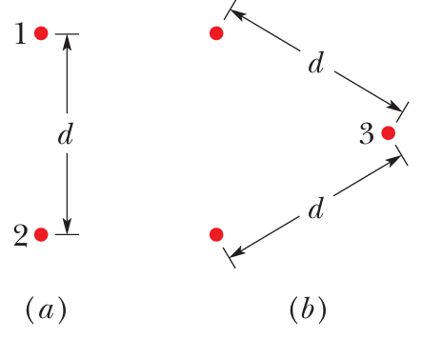

Slide 3
Question1(B):
Calculate the type of particle (electron or positron) produced in each beta decay process:
(a) when a proton transforms into a neutron, and
(b) when a neutron transforms into a proton

